Slide 1
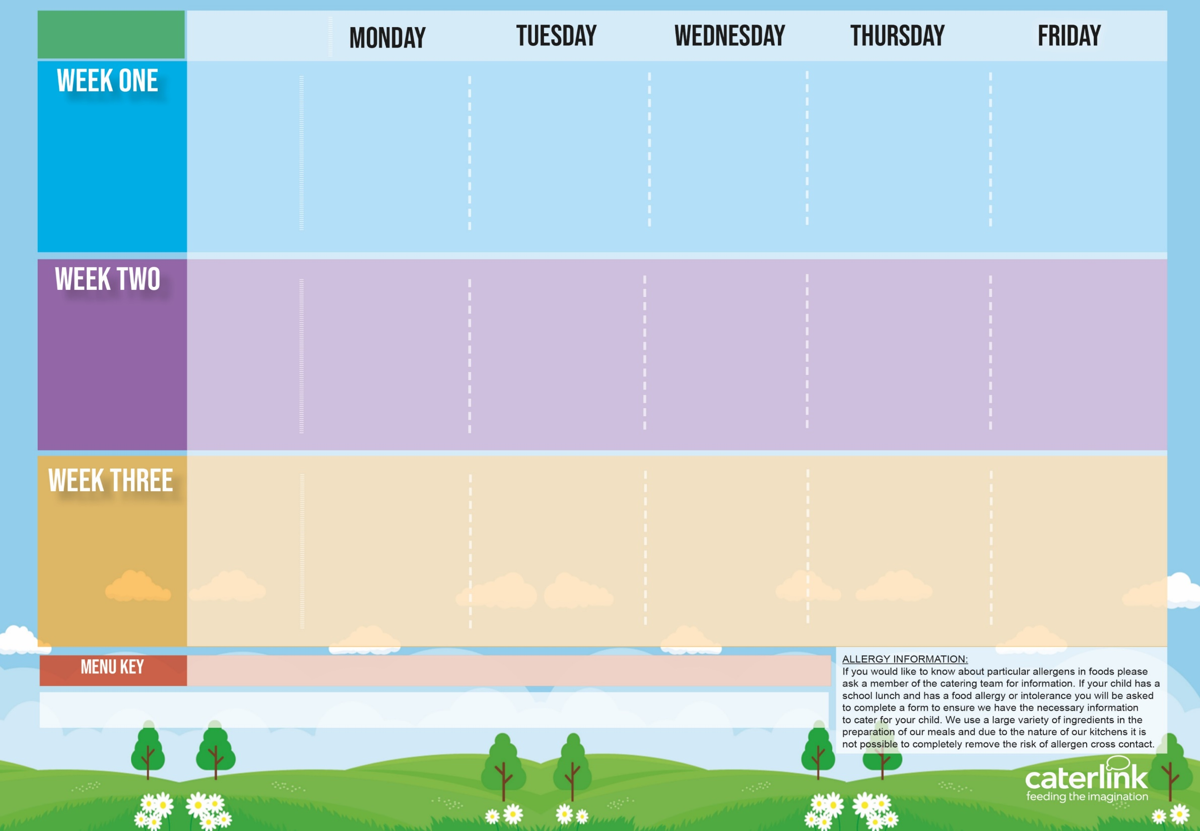
Spring Summer
2025
Option One
Option Two
Vegetables
Dessert
Macaroni Cheese | BBQ Chicken Pizza with Salads | Roasted Pork Sausage, Roast Potatoes & Gravy | Spaghetti Bolognaise | Fishfingers with Chips & Tomato Sauce
Tomato and Lentil Pasta | Mild Mexican Chilli with Rice | Roasted Quorn, Roast Potatoes, & Gravy | NEW Chefs Special Chickpea Curry with Rice | Cheese & Bean Pasty with Chips & Tomato Sauce
Vegetables of the Day | Vegetables of the Day | Vegetables of the Day | Vegetables of the Day | Vegetables of the Day
Apple Flapjack | Summer Lemon Cake | Fruit Platter | Savoury Cheese Scone | Strawberry Jelly with Mandarins
21/04/2025
12/05/2025
09/06/2025
30/06/2025
21/07/2025
15/09/2025
06/10/2025
Option One
Option Two
Vegetables
Dessert
Lentil and Sweet Potato Curry with Rice | Pork Hot Dog with Wedges & Tomato Sauce | Roast Chicken, Stuffing, Roast Potatoes, & Gravy | Chefs Special Chicken and Chickpea Korma with Rice | Battered Fish with Chips & Tomato Sauce
Cheese and Tomato Pizza with Salads | Vegan Hot Dog with Wedges & Tomato Sauce | Vegetable Soya Roast, Stuffing, Roast Potatoes & Gravy | Spaghetti and Meatballs | Cheese and Tomato Quiche with Chips
Vegetables of the Day | Vegetables of the Day | Vegetables of the Day | Vegetables of the Day | Vegetables of the Day
Iced Vanilla Sponge | NEW Strawberry and Apple Crumble with Custard | Freshly Chopped Fruit Salad | Peaches and Ice Cream | Vanilla Shortbread
28/04/2025
19/05/2025
16/06/2025
07/07/2025
01/09/2025
22/09/2025
13/10/2025
Option One
Option Two
Vegetables
Dessert
Smokey Bean Burger with Potato Wedges | NEW Green Thai Chicken Curry with Rice | Roast Turkey, Stuffing, Roast Potatoes & Gravy | NEW Greek Macaroni Pastitsio (Macaroni with bolognaise) with Greek Salad and Tzatziki | Breaded Fish and Chips
Classic Vegan Bolognaise | NEW Chefs Special Five Bean Jollof Rice | Veg Wellington, Roast Potatoes & Gravy | Spinach and Cheese Whirl with Rice, Greek Salad and Tzatziki | All Day Vegetarian Breakfast
Vegetables of the Day | Vegetables of the Day | Vegetables of the Day | Vegetables of the Day | Vegetables of the Day
Pear & Cocoa Upside Down Cake | Cheese and Crackers | Fruit Medley | Jam and Coconut Sponge | Oaty Cookie
05/05/2025
02/06/2025
23/06/2025
14/07/2025
08/09/2025
29/09/2025
20/10/2025
Added Plant Protein
Wholemeal
Vegan
Chef’s Special
Available Daily: - Freshly cooked jacket potatoes with a choice of fillings - Bread freshly baked on site daily- Daily salad selection – Fresh Fruit and Yoghurt

